Slide 1
Complement System

Slide 2
Lecture outline
a. Describe the classical pathway of complement activation in terms of C1 and its subunits; C4 and its subunits; C2 and its subunits; and C3 and its subunits.
b. For the alternative complement pathway, list the activating substances for initiation of this system and describe the role of C3b, factor B, factor D, properdin, factor H, and factor I in this pathway.
c. Describe the three different functions—recognition, activation, and membrane attack.
d. Discus the synthesization and composition of complement.
e. Describe regulators of the complement system, both fluid phase and membrane bound.

Slide 3
Contents
Characteristics
Classical pathway:
Activators
early steps
Lectin pathway:
Activators
early steps
Alternative pathway:
Activators
early steps
Activation of C3 and C5
Terminal pathway
Regulation of complement system
Biological functions of complement system

Slide 4
Discovery
Bac + Fresh serum (specific Abs)→ Lysis of Bac
Bac + heated serum at 56⁰C (specific Abs) → No lysis

Slide 5
General properties
1. comprise more than 30 circulating and mem-expressed proteins
2. Most of them are proteases
3. Synthesized in the liver and by cells involved in the inflammatory response.
3. Heat-labile killed at 56⁰C for 30 min
4. Normally they are inactive and become activated due to microbes
5. Do not increase upon immunization
6. Their serum conc. in human vary between 20 µg/ml of C2 and 1300 µg/ml of C3

Slide 6
C act in a cascade amplification system like coagulation system
One of the major effector mechanism of humoral immunity and an important mechanism of innate immunity
C is a nonspecific serologic reagent. C of one animal species react with Ig of another species. The more distant the taxonomic position of the 2 species, the less interaction occurs
C is present in all normal mammalian sera including fish and birds

Slide 7
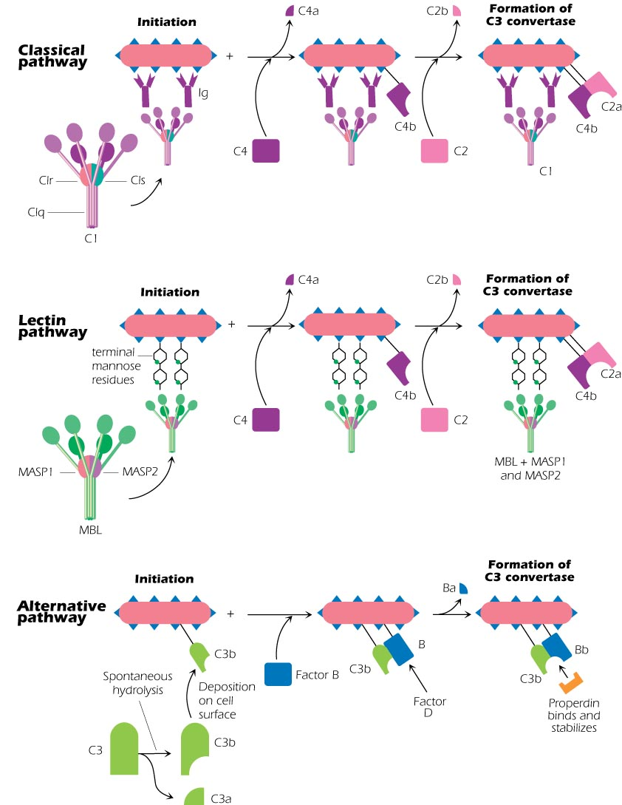

Slide 8
Early Steps
Classical Pathway
Activators
Ag-Ab complexes: C1 binds Fc region of 2 closed IgG or 1 IgM molecule
Aggregated Ig
C-Reactive protein (CRP) that bind surface phosphocholine of bac
Some viruses HIV
Not all classes of Ig are equally effective:
IgM> IgG3>IgG1>IgG2
T-dep and TI Ags elicit IgM i.r and both activate Complement system

Slide 9
Early steps
The protein components are labeled numerically C1, C2 itc……
C1 consist of 3 different enzymes: q, r, s
C1q binds Fc region of Ig-bound to Ag
C1r become activated followed by C1s.
C1 esterase: cleave C4 into C4a, C4b. C4a small remains in fluid phase and C4b linked covalent to surface pathogen
Pathogen-C4b then binds C2 and become Substrate for C1s.
C1s cleave bound C2 into C2b in fluid and C2a bound to C4b pathogen-C4b-C2a
C3 convertase = pathogen-C4b-C2a

Slide 10
Lectin Pathway
Activators
Teminal mannose expressed by Gm+ and gram – Bac
Mannose is not found on the surface of mammalian cells—self and nonself discrimination
Early steps
Pathogen-mannose bind (MBL) protein that is homologous to C1q in the classical pathway bind mannose-associated serine proteases (MASP). MBL-MASP-1 and MASP-2
Pathogen-mannose—MBL—MASP-1—MASP-2
MASP-2 cleave bound C2 into C2b in fluid and C2a bound to C4b pathogen-C4b-C2a
C3 convertase = pathogen-C4b-C2a

Slide 11
Alterative pathway
Activators
Any foreign substance in the absence of Ab
Early steps
C3 spontaneous hydrolysis to small fragment C3a and large C3b cleavage of reactive thiol group
C3b deposition on the cell surface of pathogen
AP is always ON
Pathogen-C3b bind to another protein Factor B Pathogen-C3b-B
Factor D split B into small Ba and large Bb fragment
(Pathogen-C3b-Bb-Properdin factor) C3b-Bb is unstable so Properd into stabilize the complex

Slide 12
Activation of C3 and C5
Classical and Lectin pathways
C3 convertase cleave C3 into small fragment C3a and large C3b
C3b binds C4b-C2a to make Pathogen-C4b-C2a-C3b (C5 convertase)
C5 convertase cleave C5 into small C5a in fluid and C5b attached to the pathogen not to the convertase

Slide 13
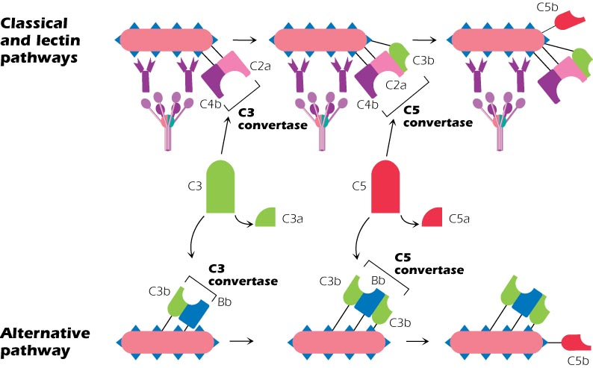

Slide 14
Alternative pathway
Pathogen-C3b-Bb-P bind C3b to make C5 convertase ---Pathogen-C3b-Bb-C3b-P
C5 convertase cleave C5 into small C5a in fluid and C5b attached to the pathogen not to the convertase
This is example of positive feedback or amplification loop: C3b bind the pathogen and increase the process

Slide 15
Terminal Pathway
Pathogen-C5b will bind to C6-C7-C8 so C5b-C6-C7-C8 is a Receptor for C9
C9 is a perforin-lke component binds to C8. Polymerization of C9 monomers occurs to form a transmembrane structure called MAC or mem attack complex
The MAC will disturb the osmotic equilibrium of the pathogen and the membrane becomes permeable to macromolecules and cell lysis

Slide 16
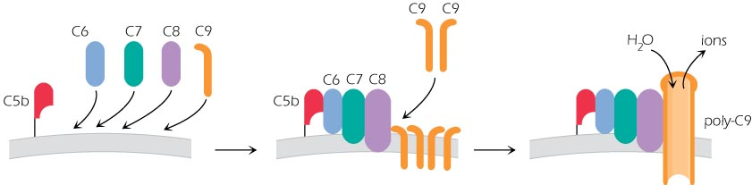

Slide 17
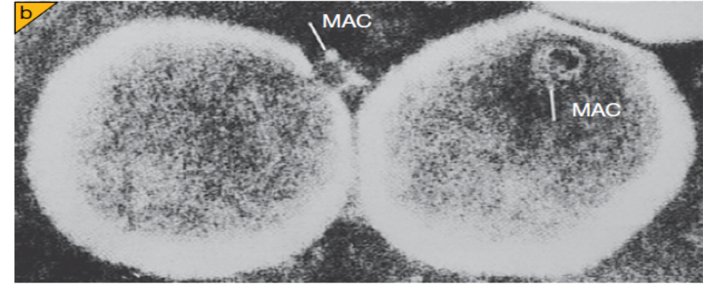
Electron micrograph of a membrane C5b–9 complex incorporated into liposomal membranes clearly showing the annular structure. The cylindrical complex is seen from the side inserted into the membrane

Slide 18
Regulation of complement system
C1 esterase INH
Serum protein that inhibit the first step of classical, lectin and alternative pathway
C1INH bind C1s and MASP-2 and C3bBb

Slide 19
Inhibition of C3 convertase
Classical pathway
C4b-binding protein (C4bBP), Decay accelerating factor (DAF), CR-1 and Membrane cofactor protein (MCP) are produced by mammalian cells but not by microbes. In this way, C3b does not interact with our own cells but is able to interact with microbial cells
These displace the C2a so C4b-CR-1, C4b-BP, MCP This make good substrate for factor I that cleave C4b into C4c and C4d
DAF dissociate C4b-C2a but does not act as cofactor for Factor I
Factor H, DAF, CR-1 and MCP displace Bb in the alternative pathway
Factor I cleave C3b to C3d and C3c.
DAF dissociate C4b-C2a but does not act as cofactor for Factor I

Slide 20
Alternative pathway
Factor H: two functions in the alternative pathway:
a. compete with factor B to bind C3b on cell surface
Sialic acid found on mammalian cells favor factor H while Bacteria lack sialic acid favor binding C3b or B factor.
b. binds to C3 convertase , displaces Bb, prevent further activation and become cofactor for I

Slide 21
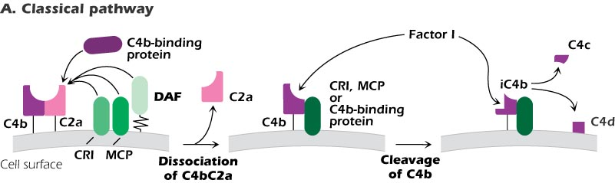
MCP, CR1, and DAF are produced by mammalian cells but not by microbes

Slide 22
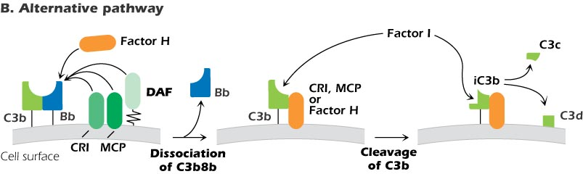
If C3b is deposited on the surfaces of normal mammalian cells, it may be bound by several membrane proteins, including MCP (CD46), CR1, and DAF, and the plasma protein Factor H.

Slide 23
Regulation of terminal steps
a. innocent bystander cells have CD59 protein on surfaces that prevent lysis of cells by binding to C5b-C8 complex so preventing C9 polymerization (MAC)
b. Vitronectin and clusterin proteins fluid proteins bind C5b6 and C5b6,7 C5b6,7 ,8 and prevent interaction with membranes

Slide 24
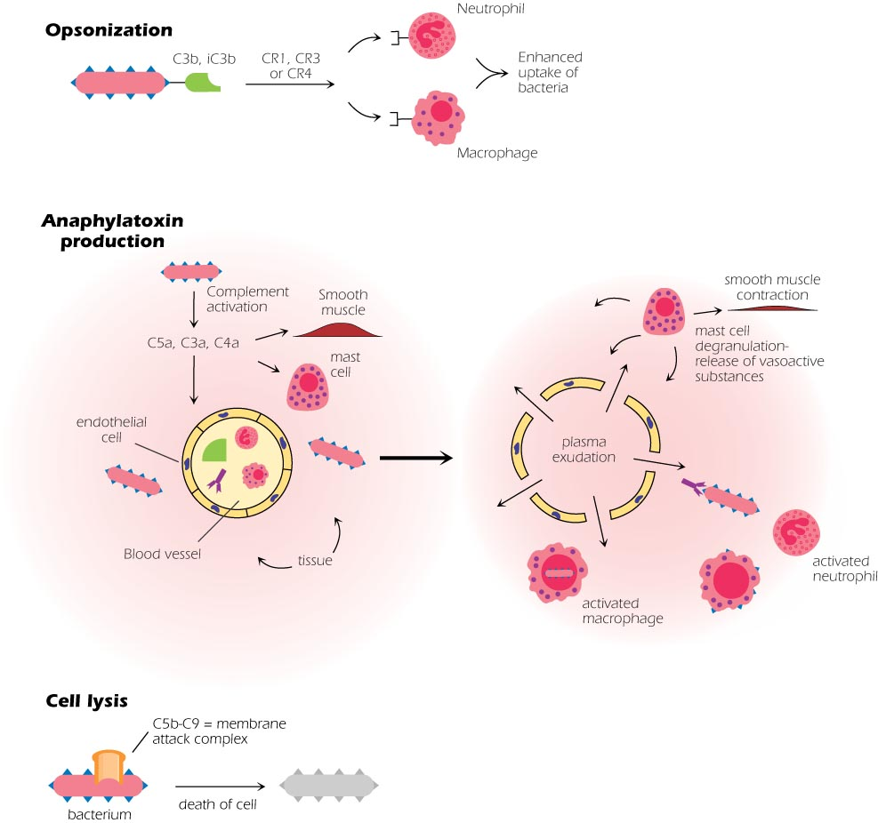
Biological activities of complement

Slide 25
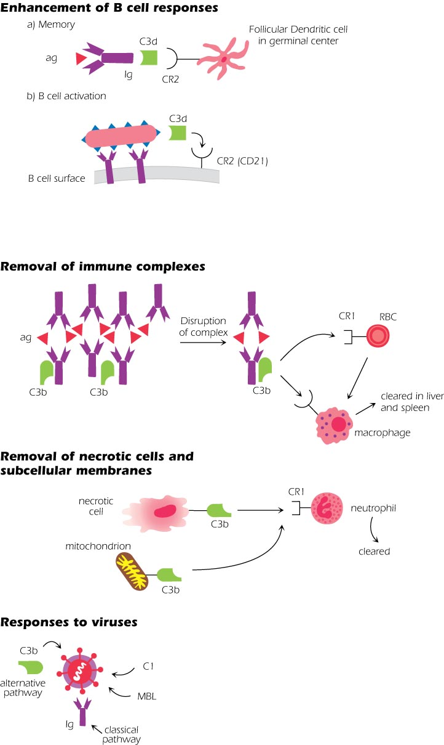

Slide 26
Biological activities of complement
Cell lysis: not all Ags are susceptible to lysis by C. Yeast, most of gram + bacteria, most plant cells and most mammalian cells resist c-mediated lysis. Erythrocytes, WBCs, platelets and gram-bacteria are susceptible.
Opsonization
Promoting the attachment of antigens to phagocytes (enhanced attachment or opsonization)
Opsonins: C3b and C4b
Bac-Opsonin------------CR-phagocyte

Slide 27
Anaphlatoxins
Triggering inflammation: C5a is the most potent complement protein triggering inflammation.
C5a> C3a> C4a potency
Bind receptors on blood vessels endothelial cells:
  a.increase V. permeability---edema ---immune Abs and cells to enhance i.r
  b. Chemotactic for neutrophils
  c. induce smooth muscle contraction
  d. interaction with mast cells and basophils release histamine and other mediators that increase v. permeability and smooth muscle contraction

Slide 28
Enhancement of B cell response
Activation of B cells:
C3d bind CR2 (CD21) on B cells and enhance i.r 1000 folds
Surface B cell—sIgM—Ag—c3dg—CD21—surface B cells
b. Induction of memory cells
depletion of complement by copra venum factor interferes with memory cell formation and secondary i.r.

Slide 29
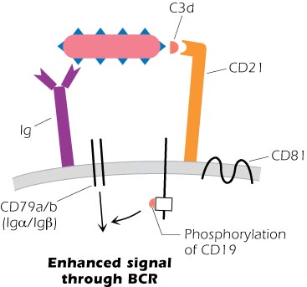

Slide 30
Removal of Immune complexes IC
Ag + multivalent Ag like bac → large insoluble IC
In vitro: useful in diagnosis
In vivo: can be detrimental to the host
Deposition of C3b breaks up the large IC into smaller pieces---cleared by phagocytosis
Deposition of C3b on Ag-Ab complexes allows binding RBCs with C3bR---Erythrocytes clear the complexes from the circulation by transporting them to the liver and spleen---macrophage-associated protease cleave CR1 followed by phagocytosis.

Slide 31
XXX Removal of necrotic cells
Physiological process
Dying cells activate complement by deposition of C3b---followed by phagocytosis
Subcellular fractions like mitochondria activate c
Pathological process
Ischemia: area of tissue dies after blood and O2 supplies have been cut---cardiac attack
C is considered a major contributor to the inflammatory response

Slide 32
XXX Response to Viruses
C plays a role in defense against viral infection including retroviruses, lentiviruses
Escape mechanisms
  Some V produce proteins that mimic C inhibitor like DAF
  Some V bind to CR such as EBV bind CR2
  Some V bind C3b, bind the host CR. HIV use CR2 to infect T, B cells

